Slide 1
Fund Overview
Est. 2005

Slide 2
Why We Do This
In 1969, Mary Davis Porcari lost the youngest of her five children, Mary Elizabeth, to a rare genetic disorder. Following this tragedy, Mary was determined to become a Registered Nurse – like her mother before her.
While raising her surviving children at home, Mary enrolled in the nursing program at Monroe Community College in Rochester, N.Y., studying nights, weekends and holidays to earn her RN in 1972. Mary went on to a career as a Medical-Surgical nurse, also volunteering at local non-profits when time allowed.
Remarried, Mary Porcari Brady retired in 2000, passing unexpectedly in 2001.
With their late Mom’s lessons of service and committing to something larger than oneself in mind, in 2005 her four surviving children approached the Monroe Community College School of Nursing and asked them to identify an unmet need. In 2006, the MPB Fund was born.
For more information, please visit us at mpbfund.com
2

Slide 3
MISSION & PURPOSE
The Mary Porcari Brady Fund is a 501(c)3 Charitable Organization established in 2006 at Monroe Community College with a $250,000 seed grant from Mary’s surviving children.
Designed into that commitment was a caveat that 100% of all funds be used to assist student nurses, with all overhead and administrative costs donated by the Fund Managers, and managed entirely by the Nursing School faculty.
Also:
All donations are confidential unless donor wishes otherwise
We do not solicit donors for other purposes
Donations can be designated in honor of an individual, family or organization
We do not sell or share donor information, ever
For more information, please visit us at mpbfund.com
2

Slide 4
THE PROBLEM
According to BLS Employment Projections, the anticipated need for Registered Nurses (RN) in the US workforce is expected to grow by at least 6% in the coming decade.
Unfortunately, RN graduation rates fell nationwide due to poor economic conditions and outbreak of COVID-19.
[1]
Full Time RNs 1982 - 2021
3.5M
[2]
The total supply of RNs decreased by more than 100,000 from 2020 to 2021.
Age <35
Age 35-49
Age 50+
Total FTE RNs
3M
2.5M
To enhance patient safety, the number of baccalaureate-prepared RNs must be raised to at least 80%.
2M
[3]
1.5M
The current RN workforce falls short of this, with only 65.2% of RNs prepared at the baccalaureate or graduate level.
1M
[3]
500K
[1] https://www.bls.gov/ooh/healthcare/registered-nurses.htm#tab-6
[2] https://www.healthaffairs.org/content/forefront/worrisome-drop-number-young-nurses
[3] https://pubmed.ncbi.nlm.nih.gov/24983041/
‘82
‘85
‘90
‘95
‘00
‘05
‘10
‘15
‘21
3

Slide 5
THE REALITY
Many nursing students live “paycheck-to-paycheck”, in situations where even a single unexpected financial hit (vehicle breakdown, partner status change, child healthcare, etc.) can force them to drop out.
4

Slide 6
OUR SOLUTION
Assist school staff in identifying and supporting students who are at risk of leaving RN programs due to unexpected, unforeseen, or other critical financial issues.
Provide identified students with bridge grants that give them the financial support needed to remain active in their programs.
The entire grant process is administered, vetted, and approved by the chair and staff of each RN program – ensuring that informed and timely decisions can be made by those closest to the students.
Additionally, we will collaborate directly with program administrators to determine broader, one-time grants for larger groups.
EX: Providing new supply bags, covering graduation exam fees, uniform grants to incoming classes, etc.
5

Slide 7
OUR RESULTS
Since our founding in 2006, the MPB Fund has raised and successfully approved funds at every school where we are active, and in every year since inception. Additionally, in 2023 we established a partnership with the Marine Corps Scholarship Foundation.
1
3
2
5
4
Grants To-Date
Active Schools
$1.09M+
5 (+ MCSF)
1. Monroe Community College, Rochester NY
2. Onondaga Community College, Syracuse NY
3. Finger Lakes Community College, Canandaigua NY
4. Tompkins-Cortland Community College, Dryden NY
5. Cayuga Community College, Auburn & Fulton NY
Students Assisted
550+
6

Slide 8
OUR TIMELINE
2023 & 2024
Established at Cayuga Community College & Partnered with Marine Corps Scholarship Foundation
2006
2014
2022
Established at Monroe Community College
Established at Onondaga Community College
Established at Tompkins-Cortland Community College
Established at Finger Lakes Community College
Grants approved every active year (17y running)
Grants approved every active year (9y running)
Grants approved every active year (2y)
Grants approved every active year (2y running)
Additional ‘Large-Scale’ Grants
2021
2022 & 2023
2022
2023
Provided $50,000 grant for PPE & enhanced remote work software
Monroe CC
Bought uniforms & supply bags for the entire incoming class.
Onondaga CC
Purchased backpacks & surgical supplies for all new RN students.
Monroe CC
Supply kits & bags for all incoming RN students.
Finger Lakes CC
7

Slide 9
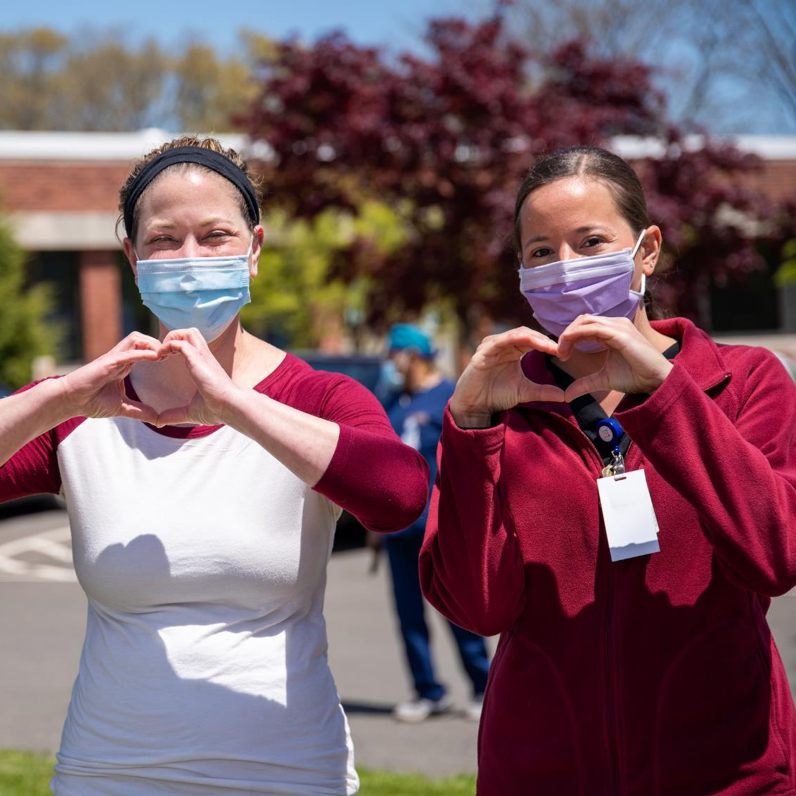
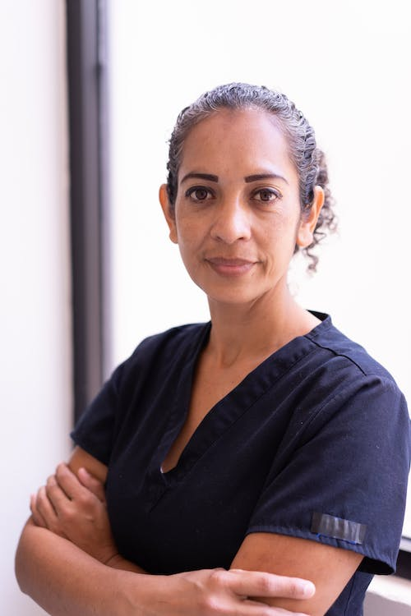
“I would like to take the time to thank you again for your help while finishing my nursing degree. As a single mom of three, it has been hard keeping up with all my living expenses while pursuing my nursing degree.
This means so much not only to me but to my family as well! Having support like this allows me to keep up with my studies and not have to stress about how I am going to pay the rent.”
R.K.
“Thank you so much for the funds you provided me to get my plumbing fixed.
Because of your generosity, I can continue with the nursing program and graduate this December.”
J.J.
OUR IMPACT
“Nursing school is hard. Students are putting their lives on hold and doing everything in their power to be successful. When something financially unexpected happens in their lives that could hold them back, The Mary Porcari Brady Fund gives Monroe Community College the ability to help students pay for those expenses so they can continue their work in the classroom. The MPB Fund allows students to keep moving forward toward their dreams, and helps them to succeed. It is truly a life-changing opportunity for so many.”
Colleen M Caruana
Department Chair MCC Department of Nursing, 2024
“After receiving this gift, I was able to focus on the important things in my life and not just maintain my grades, but bring them up to A’s.
Again, I am at a loss of words for what this means to me, and I look forward to the day when I can contribute so significantly to another deserving nursing student down the road.”
A.B.
“You were there when I had no one and had almost lost hope.
You gave me a chance without ever saying one word to me or knowing who I am….”
K.B.
To the family of Mary Porcari Brady,
I want to express my heartfelt appreciation for the financial relief this scholarship has given me. As an adult student juggling children and work it has been challenging to pay bills. I am in my last semester of nursing school and excited for the future. Receiving help with my NOCO energy bill will ease stress and ensure my home stays heated for the rest of the winter.
Thank you for this generous opportunity.
Sincerely,
K.C. - Finger Lakes Community College School of Nursing Student”, Feb 2024
“I am sincerely honored to have been selected as a recipient of the Mary Porcari Brady Scholarship. I absolutely would not have gotten to this point on my own. Thank you for your generosity.
The end of the road is in sight, and it is my goal to be successful and to walk that stage come May. Thank you very much for enabling me to continue to do the hard work to succeed.”
J.B.
8

Slide 10
OUR GOALS
We aim to expand the existing RN programs we currently support and increase the number of schools and programs we assist statewide.
Existing Programs
Increase scholarships, offer more bridge grants, provide more large-scale donations (supply bags, exam fees, etc.)
Expansion to New Schools
Our primary focus will remain on finding additional programs at community colleges throughout the SUNY system, with near term focus on the Buffalo/Niagara, Adirondack and Metro NYC areas
Near-Term Expansion Targets
Donor Relations
We can provide our Donors with a full annual report on our use of funds and allow them to target specific schools that they would like to support (if desired).
9

Slide 11
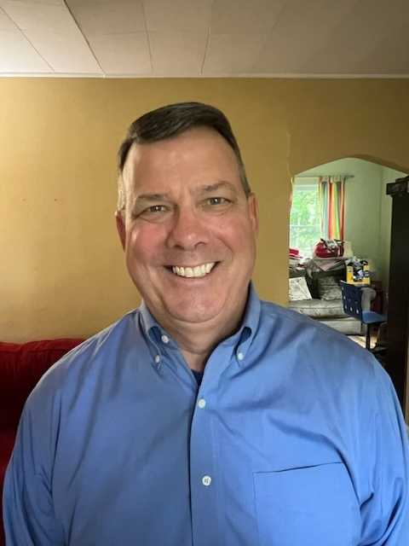
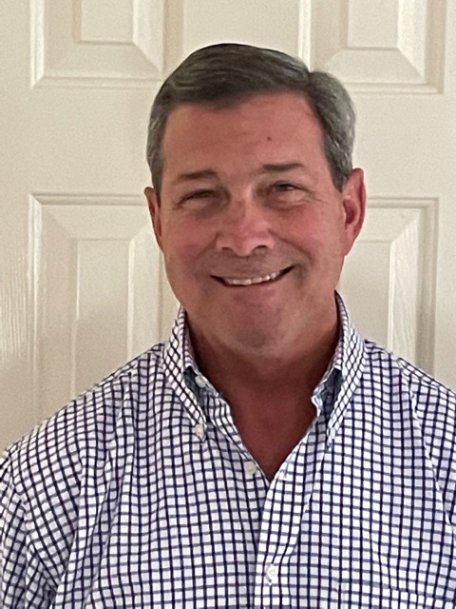
ABOUT US
Chuck Porcari
Jinny Porcari Keough
Mary Virginia (Jinny) Porcari Keough was raised in Rochester, NY, attending local public and parochial schools. She graduated from the University of Notre Dame with a degree in political science and was commissioned an officer in the United States Navy.
Jinny served 14 years on active and reserve duty, including Operation Desert Storm. She is a member of American Legion Post 140, where she serves as the posts veteran service coordinator and is an active community volunteer in Atlanta, Georgia.
Chuck is the founder and principal of Seneca Park LLC, an MD-based communications & policy consulting firm with clients in national environmental, labor & business arenas.
A former wire service reporter, Chuck spent more than 12 years serving two Governors in two different states before leading a D.C.-based communications team for a national climate advocacy org. and an international labor federation.
John Davis Porcari
Jim Porcari
John is a nationally recognized public and private infrastructure leader. John has served in senior leadership positions including Deputy Secretary of Transportation in the Obama Administration, President of the advisory services vertical of WSP/Parsons Brinkerhoff and currently sits on several boards .
John is a Managing Director of Investcorp Corsair, the Co-Founder of the Equity in Infrastructure Project (EIP), a national non-profit dedicated to generating wealth for historically underutilized businesses through public agency commitments to grow these businesses
Jim is the founder and managing partner of Insurance Resources LLC, an advisory & consultancy firm for P&C Insurers and companies supporting the insurance industry.
In addition to his work with IRI, Jim is Founder/CEO of CmySkills.com and sits on several boards. Prior to IRI’s founding in 2010 he spent 29 years at multiple Auto Insurers, many in Chief Claims Officer roles, including President of Personal Lines Claims for AIG US.
10

Slide 12
Thank You.
Learn more about us at mpbfund.com
Fund Contact: jimporcari@comcast.net

